Slide 1

Phased Array In Sound
Austin Brummett, Electrical Engineering
Advisor: Dr. Dick Blandford
Department of Electrical Engineering and Computer Science
University of Evansville
Evansville, IN 47722

Slide 2

Outline
Introduction
Client Specifications
Solution
Hardware Design
Software Design
Final Product
Budget
Phased Array in Sound
Outline
ab638@evansville.edu

Slide 3
Introduction
Used in long-rang range acoustic modern transmission, sonar imaging, ultrasound technology, and nondestructive testing
This System:
Five independently controlled speakers in a line array
Tunable phase shift via potentiometer
8-bit ADC and 8-bit DAC
Phased Array in Sound
Introduction
ab638@evansville.edu

Slide 4
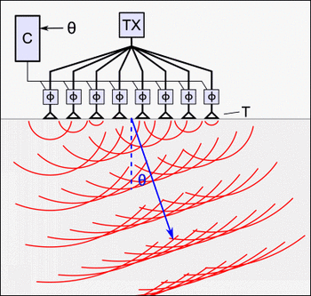
Introduction
Conceptual picture of the end result
Phased Array in Sound
Introduction
ab638@evansville.edu

Slide 5
Client Specifications
At least an 8 bit input and output
Ability for user to adjust the direction of the sound
At least 5 speakers with independent inputs
Low pass filter to deal with quantization error
Phased Array in Sound
Specifications
ab638@evansville.edu

Slide 6
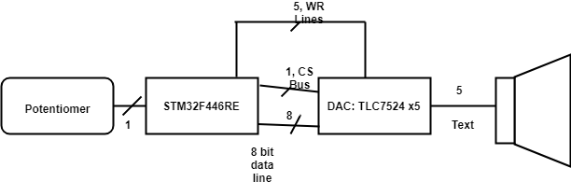
Hardware Design
Block Diagram of Design:
Important Parts:
STM32F446RET
TLC7524N DAC
Phased Array in Sound
Hardware Design
ab638@evansville.edu

Slide 7
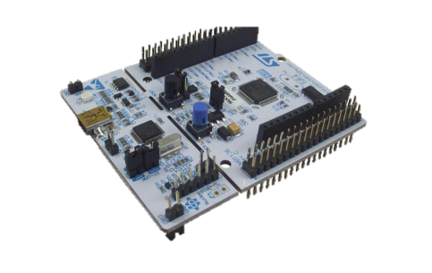
Important Parts
STM32F446RET
Does all calculations for input and output
Adjustable ADC resolution
TLC7524N DAC
Simple µController compatible interface
8 bit parallel input and 8 bit current unbuffered output
Phased Array in Sound
Hardware Design
ab638@evansville.edu

Slide 8
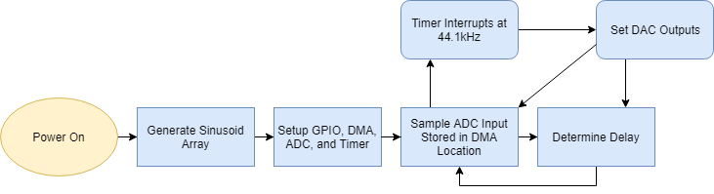
Software Design
Software Flow
Phased Array in Sound
Software Design
ab638@evansville.edu

Slide 9
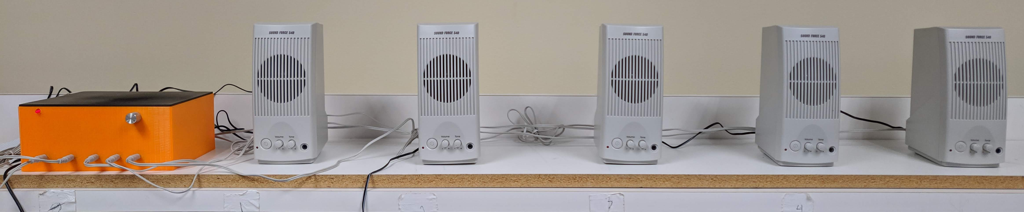
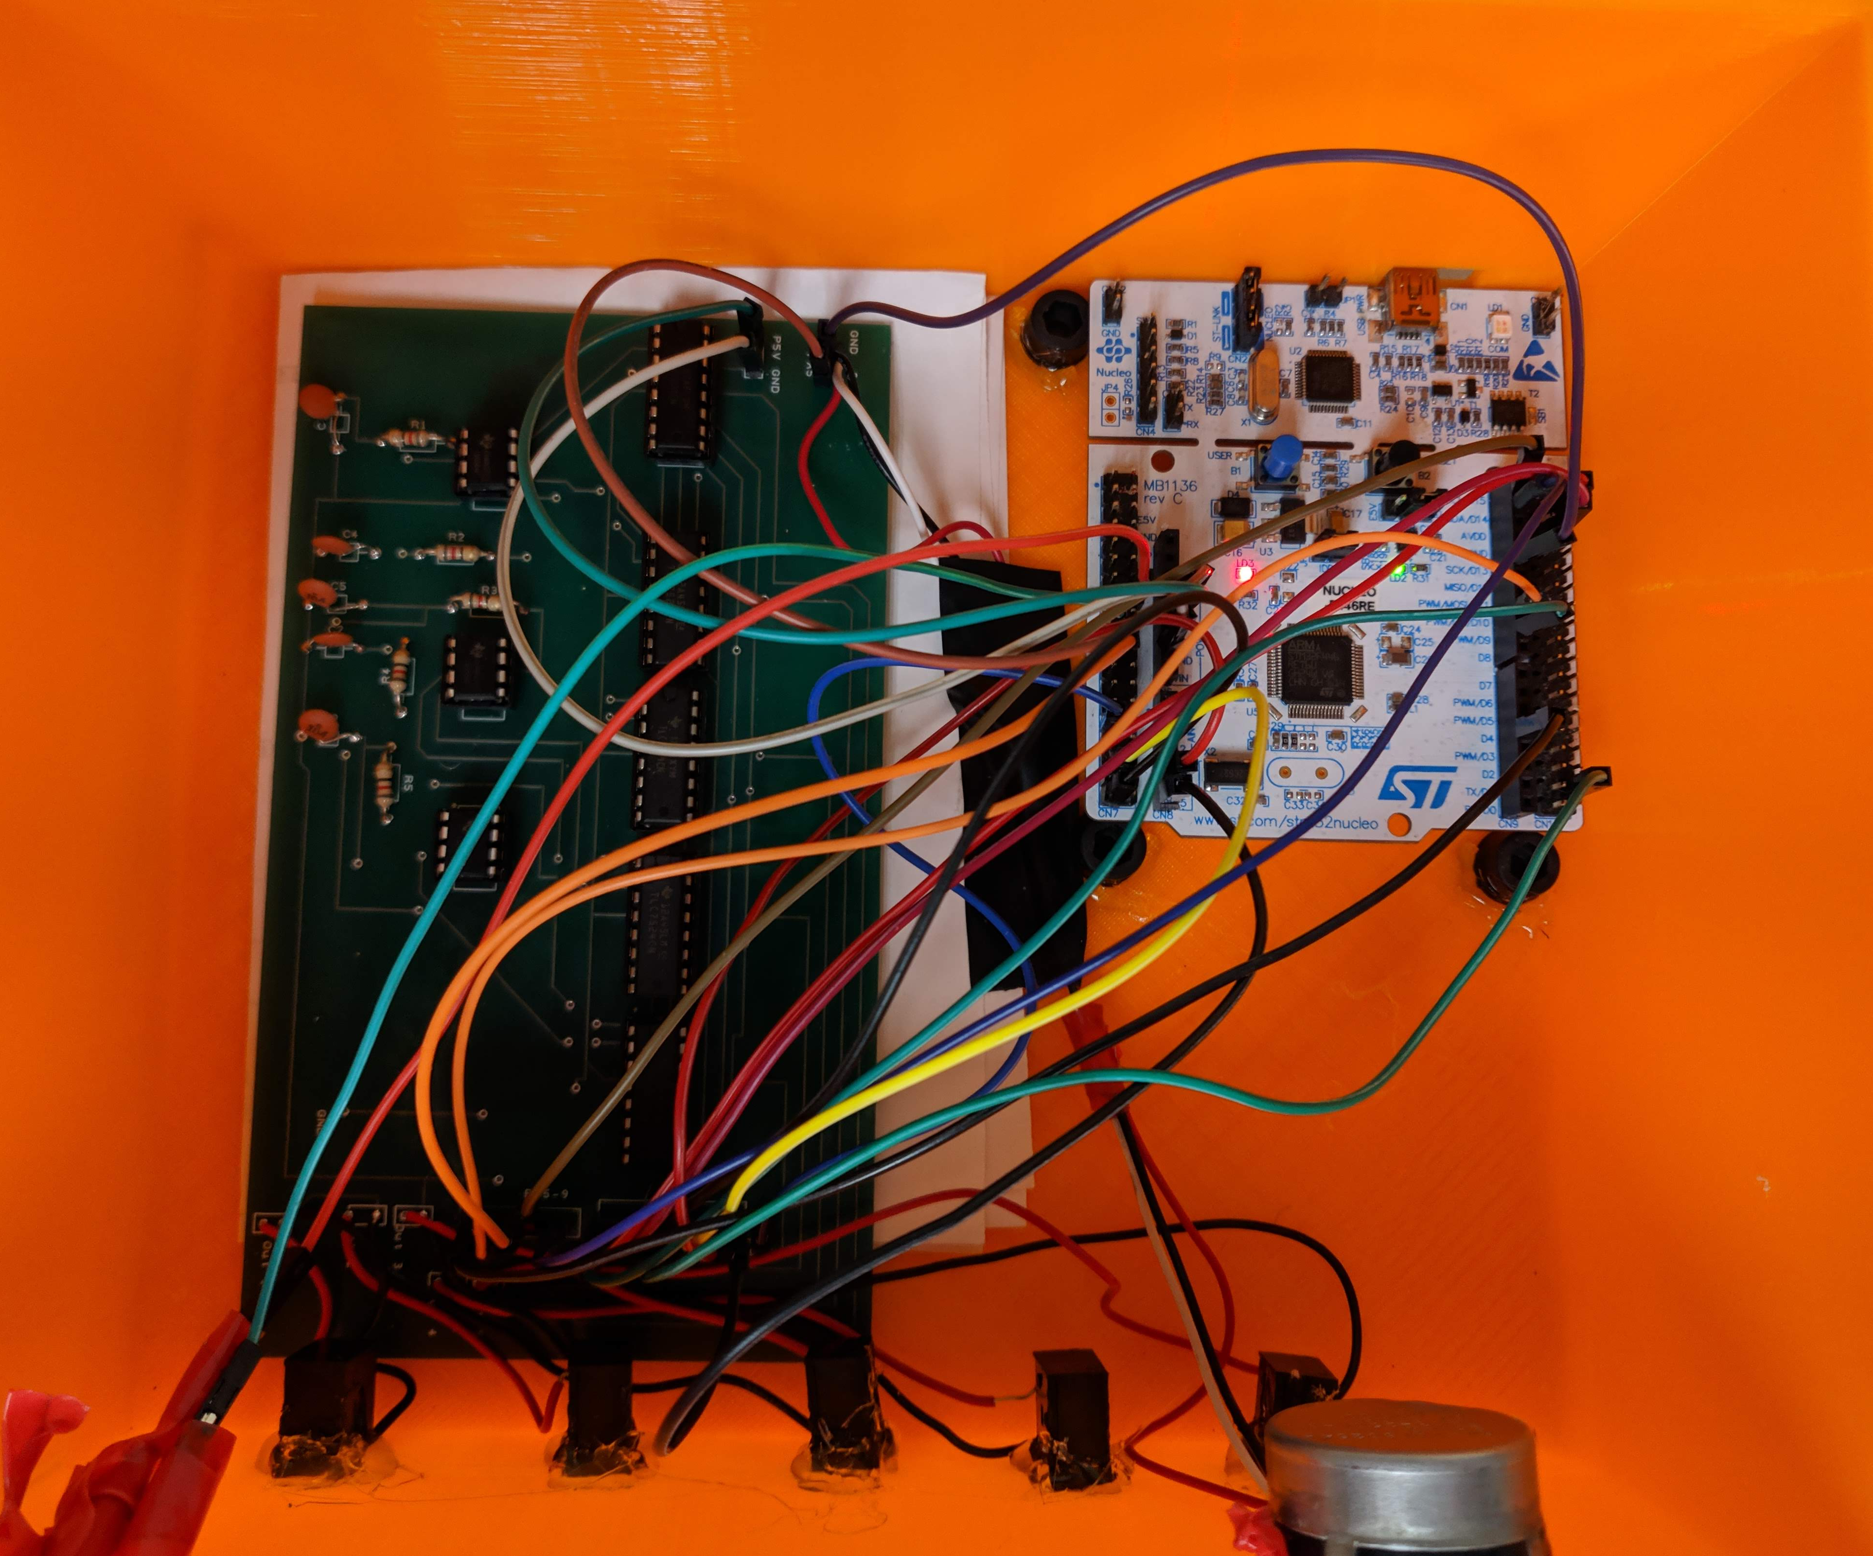
Final Product
Phased Array in Sound
Final Product
ab638@evansville.edu

Slide 10
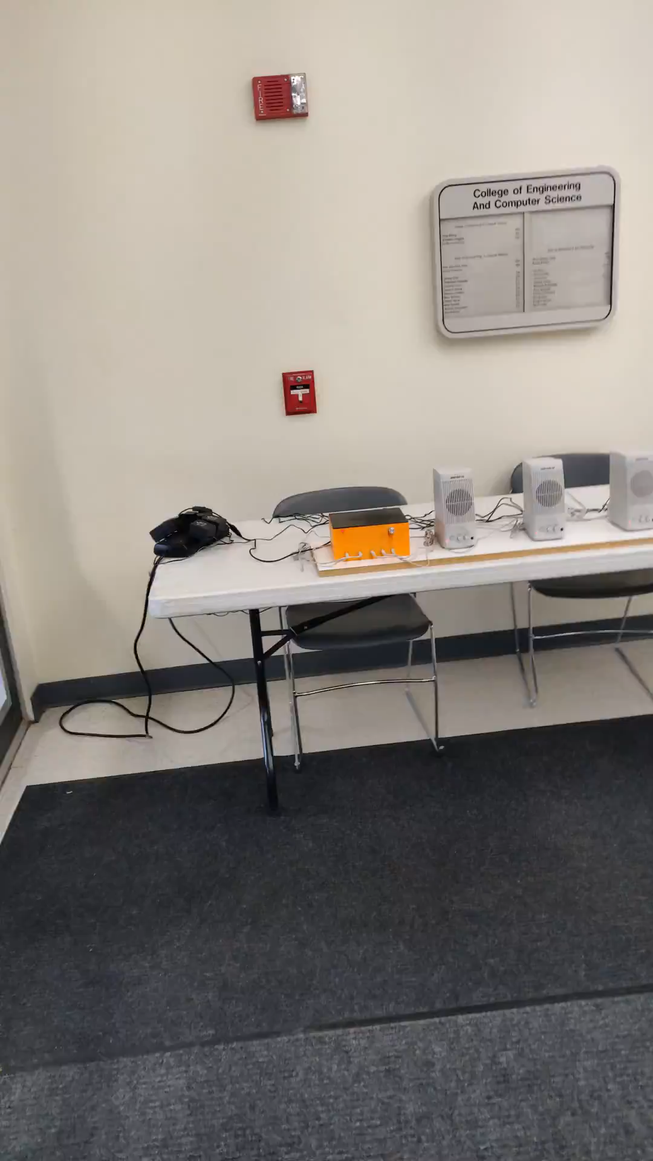
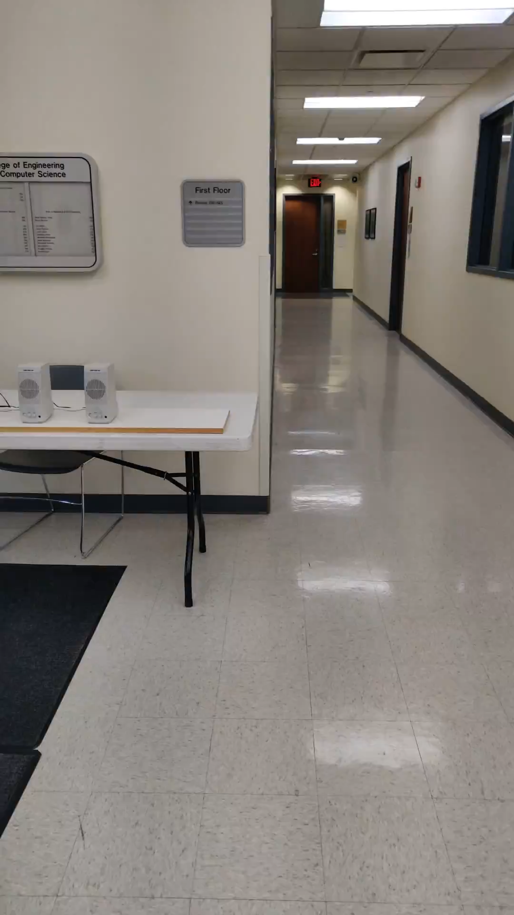
Video
+56° Shift
-56° Shift
Phased Array in Sound
Final Product
ab638@evansville.edu

Slide 11
Future Considerations
Finding a multi-channel DAC that is simple to interface
Alternate frequency mode
Sweeping mode
Reading in an audio signal vs self-generated
Phased Array in Sound
Future Considerations
ab638@evansville.edu

Slide 12
Budget
Phased Array in Sound
Budget
ab638@evansville.edu

Slide 13
Questions?
Phased Array in Sound
Final Product
ab638@evansville.edu

